Slide 1
Data Structure

Slide 2
Algorithm Design
An algorithm is a self-contained step-by-step set of operations to be performed.
Describe: in natural language / pseudo-code / diagrams / etc.
Criteria to follow:
Input: Zero or more quantities (externally produced)
Output: One or more quantities
Definiteness: Clarity, precision of each instruction
Effectiveness: Each instruction has to be basic enough and feasible
Finiteness: The algorithm has to stop after a finite (may be very large) number of steps

Slide 3
Algorithm Analysis
Space complexity
How much space is required
Time complexity
How much time does it take to run the algorithm

Slide 4
Algorithm Analysis
Space Complexity:
Its the amount of memory space required by the algorithm, during the course of its execution.
Space complexity must be taken seriously for multi-user systems and in situations where limited memory is available.
An algorithm generally requires space for following components :

Slide 5
Algorithm Analysis
✔ Instruction Space : Its the space required to store the executable version of the program. This space is fixed, but varies depending upon the number of lines of code in the program.
✔ Data Space : Its the space required to store all the constants and variables value.
✔ Environment Space : Its the space required to store the environment information needed to resume the suspended function.

Slide 6
Algorithm Analysis
Time Complexity:
Time Complexity is a way to represent the amount of time needed by the program to run to completion.
Often more important than space complexity
space available tends to be larger and larger
time is still a problem for all of us
Algorithms running time is an important issue.

Slide 7
Algorithm Analysis
Calculating Time Complexity:
Now the most common metric for calculating time complexity is Big O notation. This removes all constant factors so that the running time can be estimated in relation to N, as N approaches infinity.
In general you can think of it like this :
statement;
Above we have a single statement. Its Time Complexity will be Constant. The running time of the statement will not change in relation to N.

Slide 8
Algorithm Analysis
for(i=0; i < N; i++)
{
statement;
}
The time complexity for the above algorithm will be Linear. The running time of the loop is directly proportional to N.

Slide 9
Algorithm Analysis
for(i=0; i < N; i++)
{
for(j=0; j < N;j++)
{
statement;
}
}
This time, the time complexity for the above code will be Quadratic. The running time of the two loops is proportional to the square of N. When N doubles, the running time increases by N * N.

Slide 10
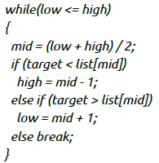
Algorithm Analysis
This is an algorithm to break a set of numbers into halves, to search a particular field.
Now, this algorithm will have a Logarithmic Time Complexity. The running time of the algorithm is proportional to the number of times N can be divided by 2 (N is high-low here). This is because the algorithm divides the working area in half with each iteration.

Slide 11
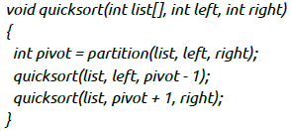
Algorithm Analysis
Taking the previous algorithm forward, above we have a small logic of Quick Sort (we will study this in detail later). Now in Quick Sort, we divide the list into halves every time, but we repeat the iteration N times(where N is the size of list).
Hence time complexity will be N*log( N ). The running time consists of N loops (iterative or recursive) that are logarithmic, thus the algorithm is a combination of linear and logarithmic.

Slide 12
Algorithm Analysis
Note:
In general, doing something with every item in one dimension is linear.
Doing something with every item in two dimensions is quadratic, and
Dividing the working area in half is logarithmic.

Slide 13
Algorithm Analysis
Time for an algorithm to run t(n):
A function of input. However, we will attempt to characterize this by the size of the input. We will try and estimate the WORST CASE, the BEST CASE, and the AVERAGE CASE.
Worst Case:
is the maximum run time, over all inputs of size n. That is, we only consider the "number of times the principle activity of that algorithm is performed".
Best Case:
In this case, we look at specific instances of input of size n. For example, we might get best behavior from a sorting algorithm if the input to it is already sorted.

Slide 14
Algorithm Analysis
Average Case:
Arguably, average case is the most useful measure.
Since the algorithm's performance may vary with different types of input data, hence for an algorithm we usually use the worst-case Time complexity of an algorithm because that is the maximum time taken for any input size.

Slide 15
Algorithm Analysis
Types of Notations for Time Complexity:
1) Big Oh denotes "fewer than or the same as" <expression> iterations (worst-case).
2) Big Omega denotes "more than or the same as" <expression> iterations.
3) Big Theta denotes "the same as" <expression> iterations.
4) Little Oh denotes "fewer than" <expression> iterations.
5) Little Omega denotes "more than" <expression> iterations.

Slide 16
Algorithm Analysis
Understanding Notations of Time Complexity with Example:
O(expression) is the set of functions that grow slower than or at the same rate as expression.
Omega(expression) is the set of functions that grow faster than or at the same rate as expression.
Theta(expression) consist of all the functions that lie in both O(expression) and Omega(expression).
Suppose you've calculated that an algorithm takes f(n) operations, where,
f(n) = 3*n^2 + 2*n + 4. // n^2 means square of n
Since this polynomial grows at the same rate as n^2, then you could say that the function f lies in the set Theta(n^2). (It also lies in the sets O(n^2) and Omega(n^2) for the same reason.)

Slide 17
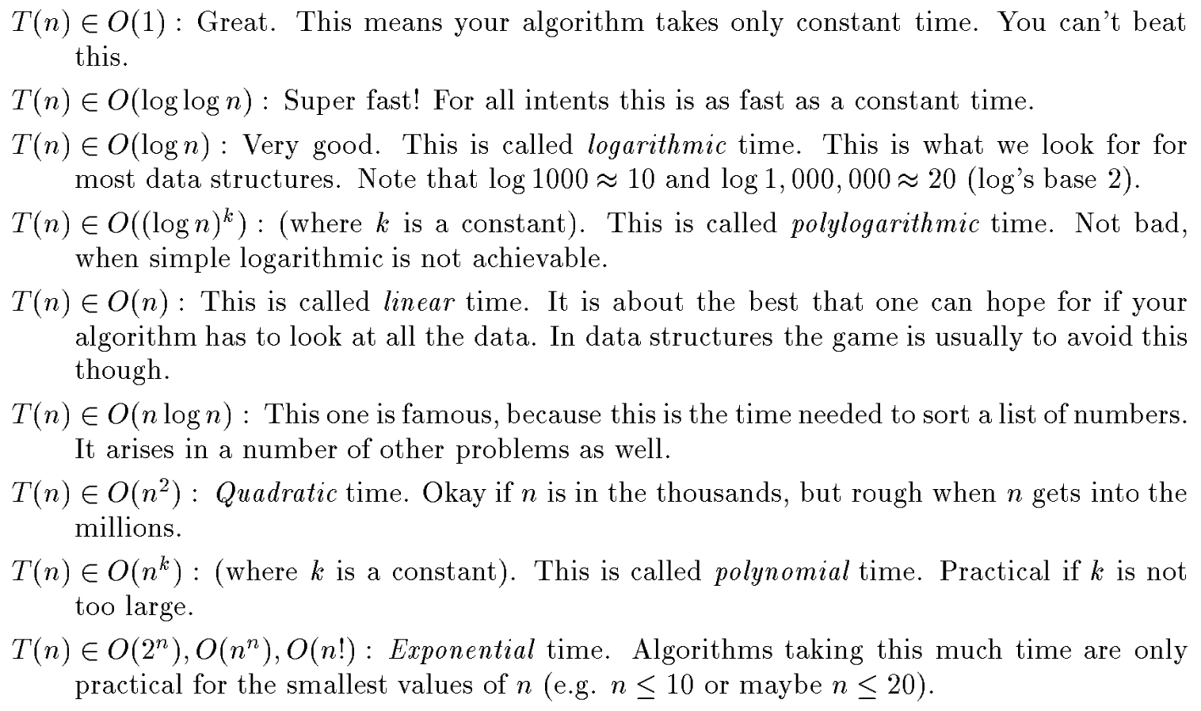
Algorithm Analysis

Slide 18
Thank You

